Slide 1
ROOMS IN THE SCHOOL

Slide 2
CLASSROOM

Slide 3
RECEPTION

Slide 4
LIBRARY

Slide 5
PRINCIPLE
OFFICE

Slide 6
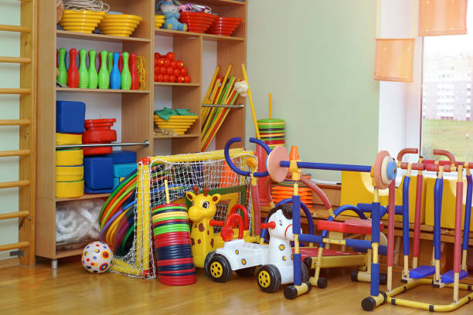
PHYSICAL EDUCATION ROOM

Slide 7
ART ROOM

Slide 8
COMPUTER LAB

Slide 9
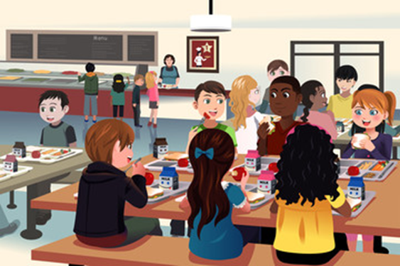
CANTEEN

Slide 10
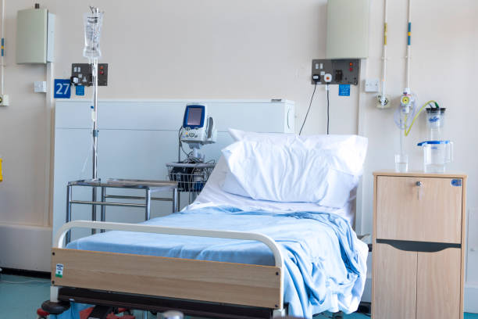
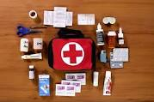
MEDICAL ROOM

Slide 11
THANK YOU

